Slide 1
Reinforcement Learning CA2
Name: Khor Yu Yang, Nevan Ang Kai Wen

Slide 2
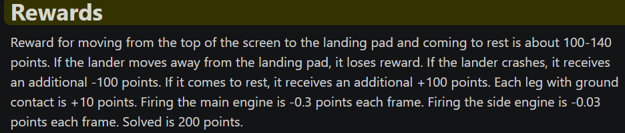
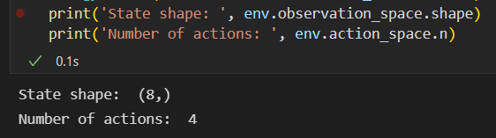
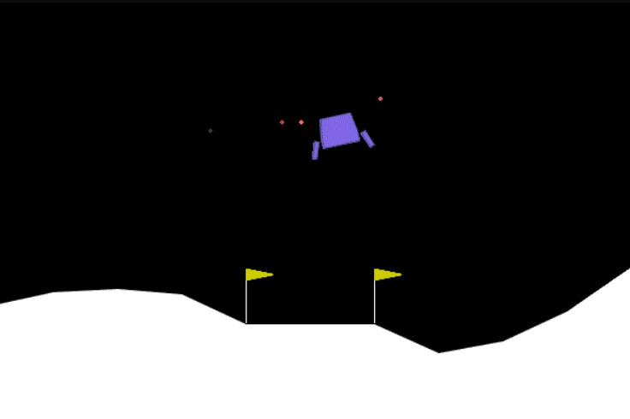
LunarLander v2
The landing pad is always at coordinates (0,0). The coordinates are the first two numbers in the state vector.
Landing outside of the landing pad is possible. Fuel is infinite, so an agent can learn to fly and then land on its first attempt
Each episode finishes if:
the lander crashes (the lander body gets in contact with the moon);
the lander gets outside of the viewport (x coordinate is greater than 1);
the lander is not awake (doesn’t move and doesn’t collide)
Objective is to have lunar lander land and get a consistent 200 score
Taken from OpenAI Official Documentation Page

Slide 3

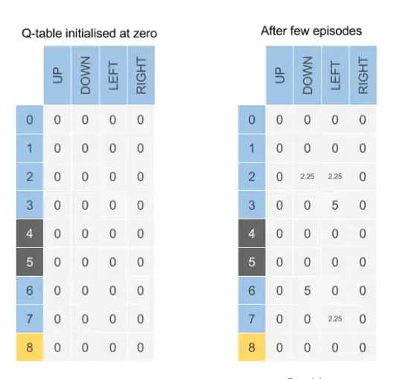
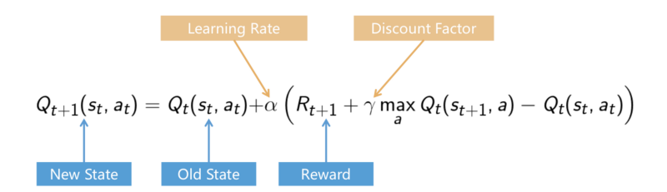
Tabular and Deep Q-Learning
Algorithms used to learn optimal policy for an agent to follow in a given environment and maximise its total rewards.
Uses an action value function Q(s,a) which represents expected cumulative reward of taking action a in state s
When agent interacts with the environment and takes actions, when it receives a reward it will update the q-function of that specification in the specific state (state-action pair)
It is updated using the bellman equation
The state-action pair will then be stored in a Q-table where the agent can make use of its Q-table ‘memory’ to decide which action to take by selecting the action that has the highest Q-value.
Over time, the Q-function converges to the optimal action-value function and its optimal policy.
Instead of an exact value function, DQN uses a function approximator.
Taken from: Practical Reinforcement Learning — 02 Getting started with Q-learning | by Shreyas Gite | Towards Data Science
Bellman equation for Q-Learning

Slide 4
Using Deep Q Learning for Lunar Lander v2
As the lunar lander has a continuous action space, it will be computationally expensive to maintain a table of Q-values for all possible states.
Deep Q-Learning handles this well as it uses neural networks to approximate Q-functions of the spaces
Used the epsilon greedy strategy, agent either selects actions randomly(exploration) or the agent selects actions based on its current policy (exploitation), which is usually the best action it has learned so far, exploration probability gradually decreases over time as agent gains more and more experience
Hyperparameters
Epsilon 1.0 (Exploration rate, determines whether model explores or exploit)
Gamma 0.99(discount factor which determines the importance of future rewards in the Q-value calculation, values future rewards more when its nearer to 1)
Learning rate 0.001
Batch_size 128
Fc1_dims 256,256
Fc2_dims 256,256

Slide 5
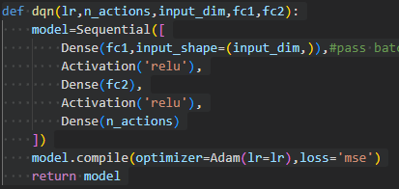
Using Deep Q Learning for Lunar Lander v2
Class replaybuffer/ agent is used so that we do not forget past experiences and to learn the probability distribution. To store experiences (state, actions, rewards,next state and done)
DQN model with 2 fully connected Dense layers (DQN Model that will be used to train)
Agent (Where the model is run, experience stored,action chosen, generate experience and learn and to save or load models)
Trained using gym
DQN Model architecture

Slide 6
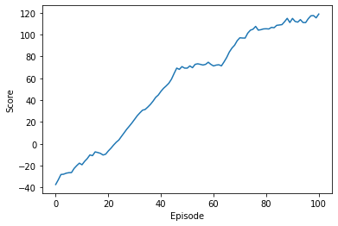
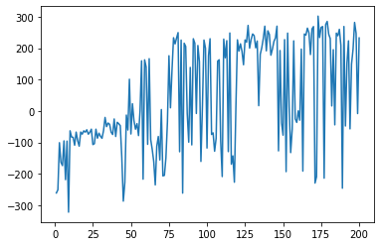
Deep Q Network without a Target Network
Model's parameters are updated in real-time as it interacts with the environment and learns from its experiences.
There are moments in the episodes (40-60 and 80-100) where there is little to no change, the rewards highly fluctuate as well.
This can mean instability in the model’s parameters, where the model is making updates to its parameters based on the current estimate of the target values, but the target values are changing rapidly, making the updates unstable.
This can negatively impact the ability of the model to learn an effective policy for the task, resulting in suboptimal performance. Hence a target network should be introduced.

Slide 7
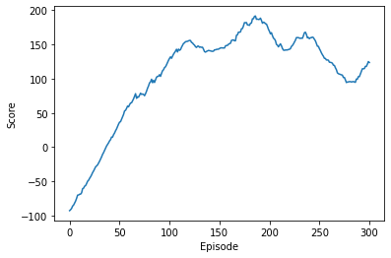
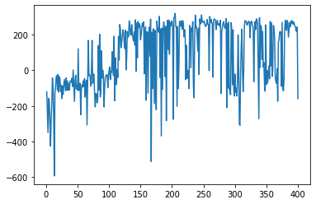
DQN Model with Target Network
The model's parameters are updated less frequently, and the target values for each update are based on the parameters of a separate target network.
Helps in stability, improved performance and faster convergence to an optimal solution. (https://arxiv.org/pdf/1312.5602.pdf)
Lesser fluctuation in rewards as episodes go on
Did not hit an average of 200
There is divergence and performance becomes worse as training goes on. Hyperparameter tuning needs to be done
Notes:
By using a target network with stochastic minibatch updates, the authors were able to achieve state-of-the-art performance on a variety of Atari games using reinforcement learning.

Slide 8
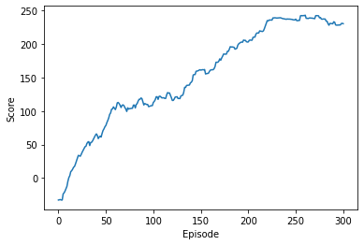
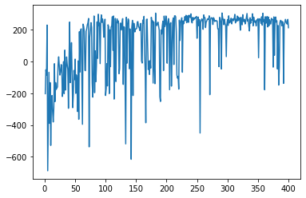
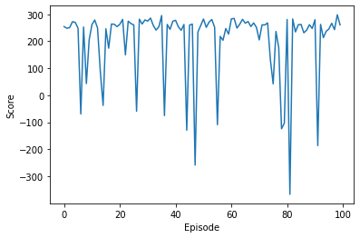
Changing Batch size
From 256 in both fully connected layers, it was changed to 150 and 130 respectively
Way lesser fluctuation in rewards in the later episodes and reached a way higher average score in the same amount of episodes
Slow and gradual improvement with no constant, stable and finding a good balance between exploration and exploitation
Hit a consistent average of 230!
Therefore i believe this is the optimal hyperparameters and batch size for this model architecture and the best dqn so far
Epsilon 1.0
Gamma 0.99
Learning rate 0.001
Batch_size 128
Fc1_dims 150
Fc2_dims 130
Testing results: An average of 204.7 reward for 100 testing episodes
Tested results

Slide 9
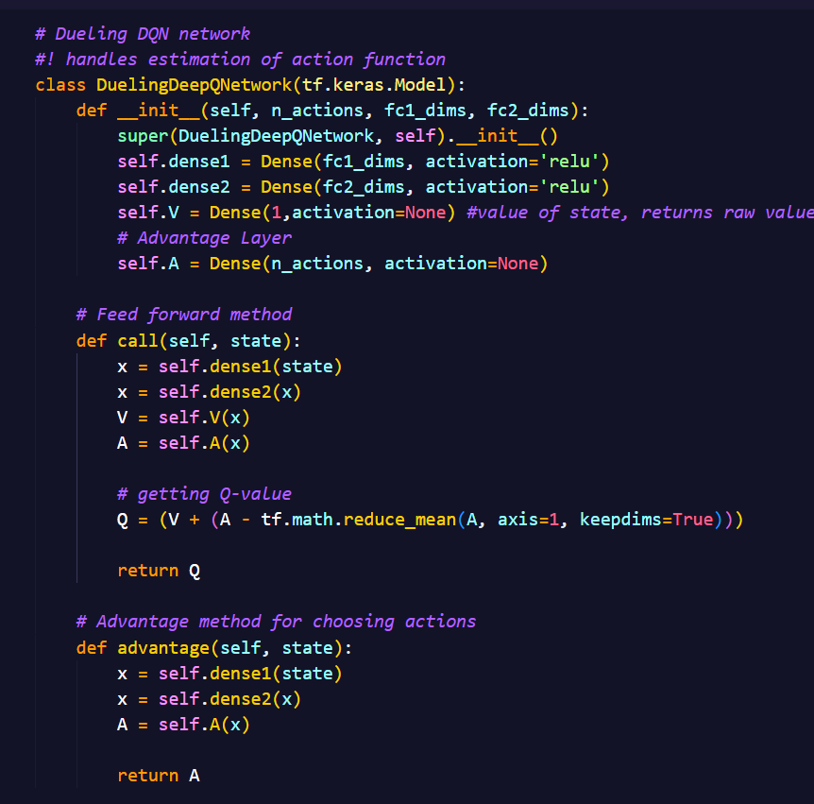
Dueling Deep Q Learning
Deuling DQN network
A variant of algorithm from Deep Q Learning
Represent the values of state (V) and the advantage values of actions (A) in a single network separately
Consists of 3 classes, ReplayBuffer, Agent and DuelingDQN network, similar to DQN
Network consists of input layer taking in input dim of 8, two output layer V & A, returning value of state and actions advantage respectively
Q-value is then derived from both V & A using the formula
Use similar ReplayBuffer class as DQN, storing memory & experiences

Slide 10
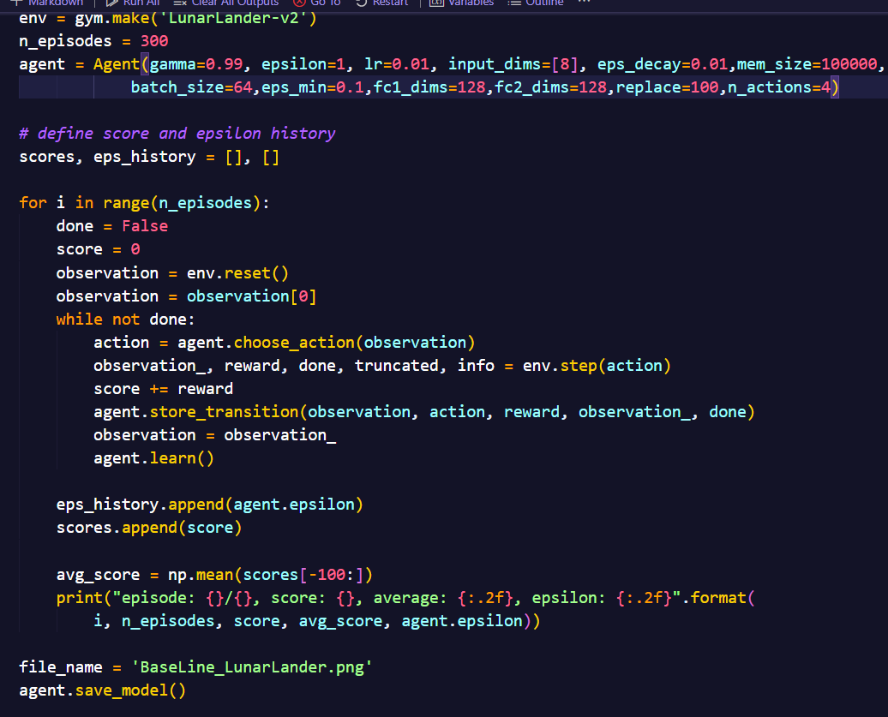
Dueling Deep Q Learning
Untuned parameters with baseline model
Baseline Model/Untuned hyperparameters
Train the agent at 300 episodes and obtain its reward, average reward and learning curve, set a baseline standard to further improve model on it
the parameters are untuned, with lr & epsilon decay at 0.01.. etc
At last episode, the average reward score is still at negative, -266.85, showing a very bad performance of agent
Not enough exploitation is done by the agent, at minimum epsilon of 0.1 might cause the performance
The model is not performing well. Improvements have to be made to make it perform better

Slide 11
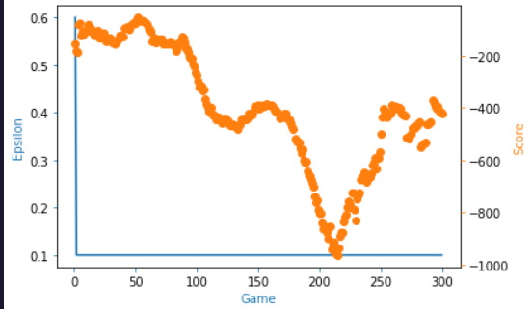
Dueling Deep Q Learning
Untuned parameters with baseline model
Modified Network
We add additional hidden layer to the network, as well as increasing number of filters to 256 and see if it will help to increase the average reward
The result returned shown that average reward is now -559.85 at episode 299
The agent performance got worse instead of improving, with even lower rewards now
We can conclude that the model layers & number of filters here is not a factor that would help us improve our agent
Learning curve show a decreasing trend, with a extreme low reward close to -1000 at episode 210
Although it started increasing back after episode 210, the reward are still at negative value
Set back the number of filters per layer to 128, and number of hidden layers to be 1

Slide 12
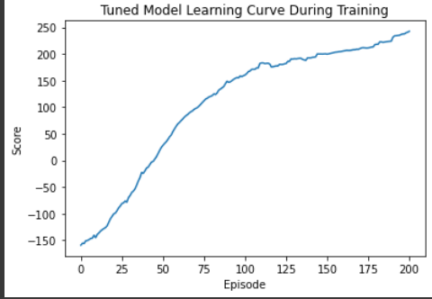
Dueling Deep Q Learning
Model After hyperparameters tuning
We tune the hyperparameters and try to improve our agent performance, since we know that the model architecture is not a factor previously
Learning rate was tuned to 1e-3, same as epsilon decay that allow the agent to slowly explore more before exploitation.
Minimum epsilon was set to 0.01 to allow to model to exploit more
Average reward hits around 229 at episodes 299, showing good performance of the agent
Graph show the moving average for score/reward, showing a increasing trend over episode, there is positive development in the score

Slide 13
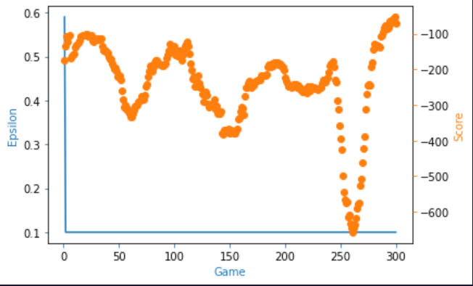
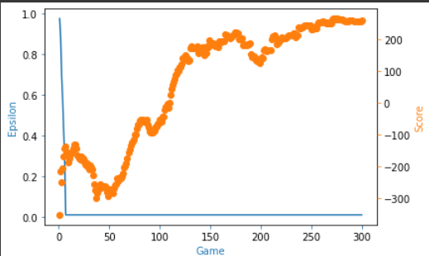
Dueling Deep Q Learning
Result of baseline model
Result of Model After tuning
Learning curve show a constant trend of score at around -200, with some drops
Agent is not learning well, with even a huge at around 255 episode to -650
Performance is poor, highest score the agent hit was only around -100 at episode 300
Learning curve show constant increasing trend of rewards from episode 0 to 300
The score/reward returned slowly hit above 0 at around 150 episode, show agent is learning well
Performance of agent is great, with maximum score hit above 200 at episode 300
Hyperparameters tuning help in improving the performance

Slide 14
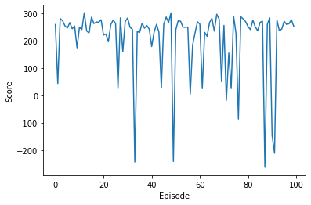
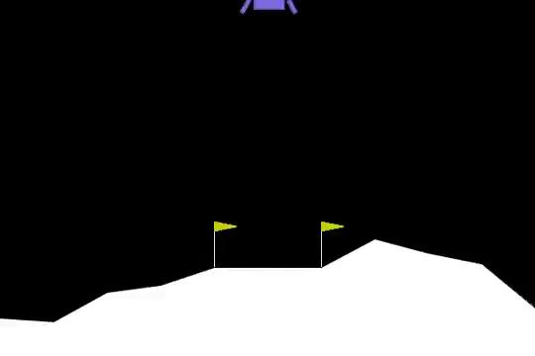


Evaluation (Testing agent with 100 episodes)
Dueling DQN
DQN
Testing
Testing
Lunar lander on episode 90
Lunar lander on episode 90
LunarLander still manage to land well between the flags properly, although the graph shows inconsistent trend
Fluctuation in testing results but is able to land lunar lander well with a high average of 200

Slide 15
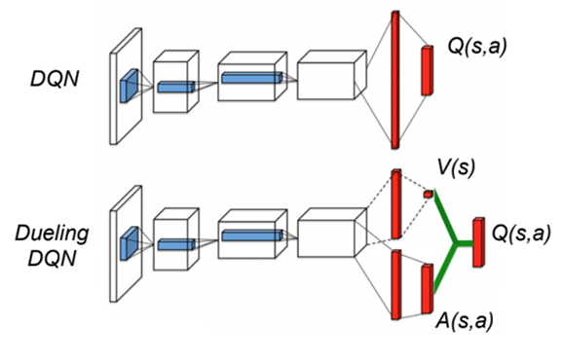
Conclusion
Dueling DQN addresses the Limitation for normal DQN
Able to determine optimal action to take in a given state more accurately
Q-value is determined from V & A
DQN is able to effectively solve lunar lander with at least an average of 200 at around 400 episodes, while Dueling DQN is able to hit that average at around 300 episodes
Best DQN has a target network and hyper parameter tuning, this goes to show that the batch sizes and a target network is important to achieve optimal performance in solving the lunar lander
Best hyperparameters for DQN is Epsilon 1.0 ,Gamma 0.99,Learning rate 0.001, Batch_size 128, Fc1 and Fc2 150,130,epsilon decay 0.996
Best hyparameters for Dueling DQN is epsilon 1, gamma 0,99, learning rate 0.001, fc1/fc2 dims 128, batchsize 64, epsilon decay 0.001
Dueling DQN consider the contribution of the state action to the overall value separately,which allows it to produce a more accurate result
Dueling DQN is the better model than DQN

Slide 16
References
Lunar Lander - Gym Documentation (gymlibrary.dev)
Practical Reinforcement Learning — 02 Getting started with Q-learning | by Shreyas Gite | Towards Data Science
1312.5602.pdf (arxiv.org)
https://www.youtube.com/watch?v=CoePrz751lg
(2) Deep Q Learning With Tensorflow 2 - YouTube
(2) Deep Q Learning is Simple with Keras | Tutorial - YouTube

